Slide 1
Advance Statistics

Slide 2
Machine learning
ML Types
Supervised : with Labels, training
Unsupervised: Without any labels, Only Computer finds patterns, learn by self !!

Slide 3
Supervised
Classification
Regression

Slide 4
unsupervised
Clustering
Associations - Rules

Slide 5
Plotly
Seaborn
Scikit
Karas
Tensorflow

Slide 6
classification
Decision Tree
Gaussian Distribution – normal
Stochastik Gradient descent SGD
Nearest Neighbour
Bayesian Regression

Slide 7
Neural Network
Biological
Artificial NN

Slide 8
Neurons
Connections
Propagation
Learning Rule
LSTM: Long short term memory

Slide 9
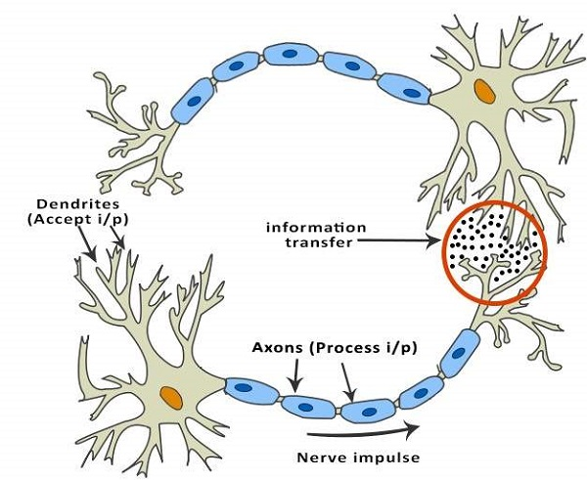
Neurons

Slide 10
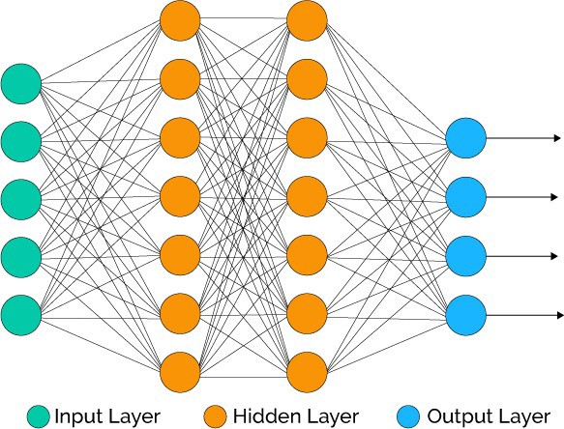
NN

Slide 11
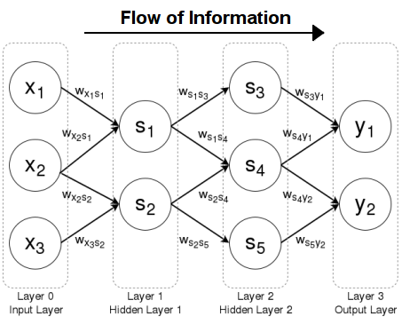
Feed Forward

Slide 12
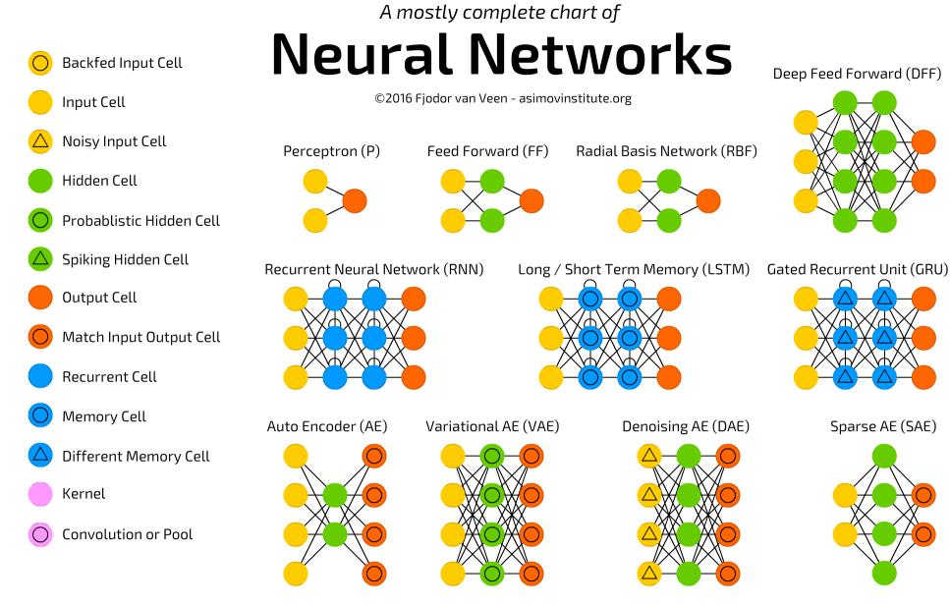

Slide 13
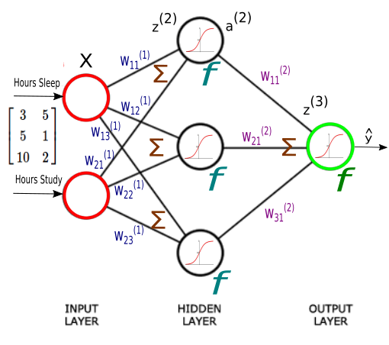
Activation function

Slide 14
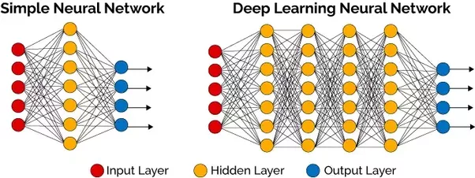
NN – Deep NN

Slide 15
Types of ANN
Single Layer
Multiple Layer

Slide 16
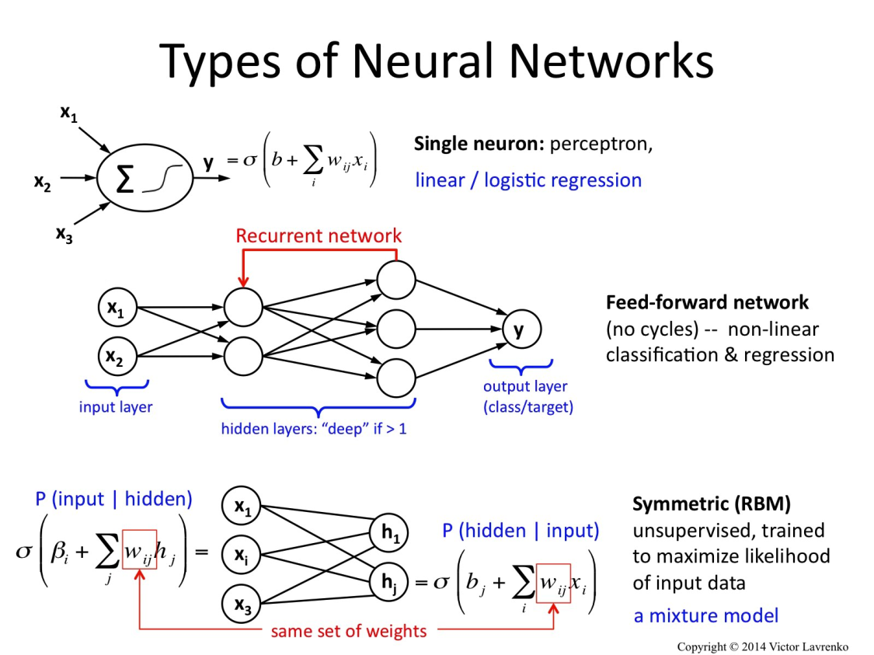
Types of ANN

Slide 17
Single
Feed Forward
Recurrent
Symmetric
Convolutional
Back propagation

Slide 18
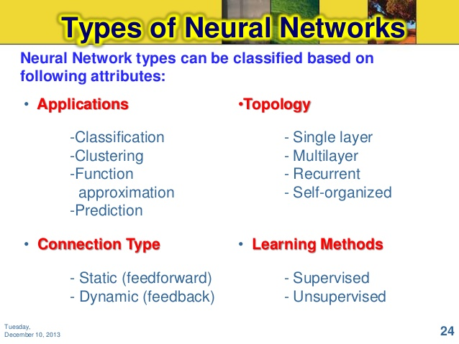

Slide 19
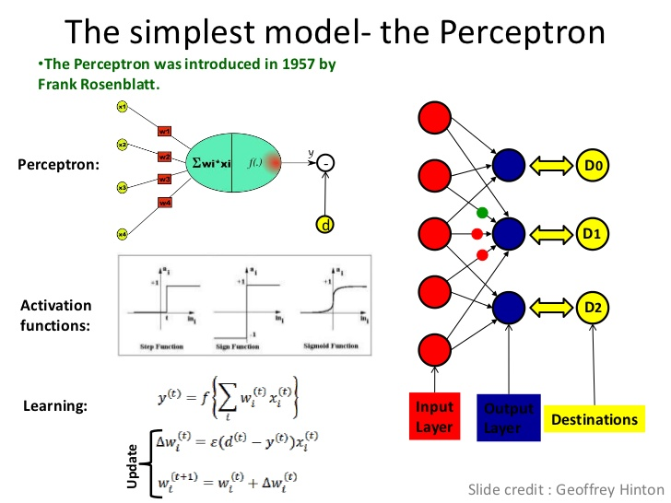

Slide 20
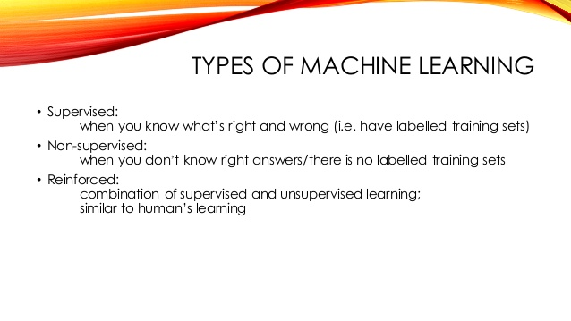
Reinforced ML

Slide 21
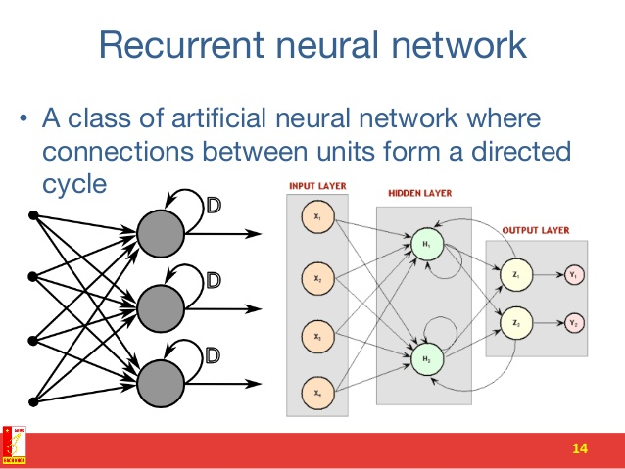
R NN

Slide 22
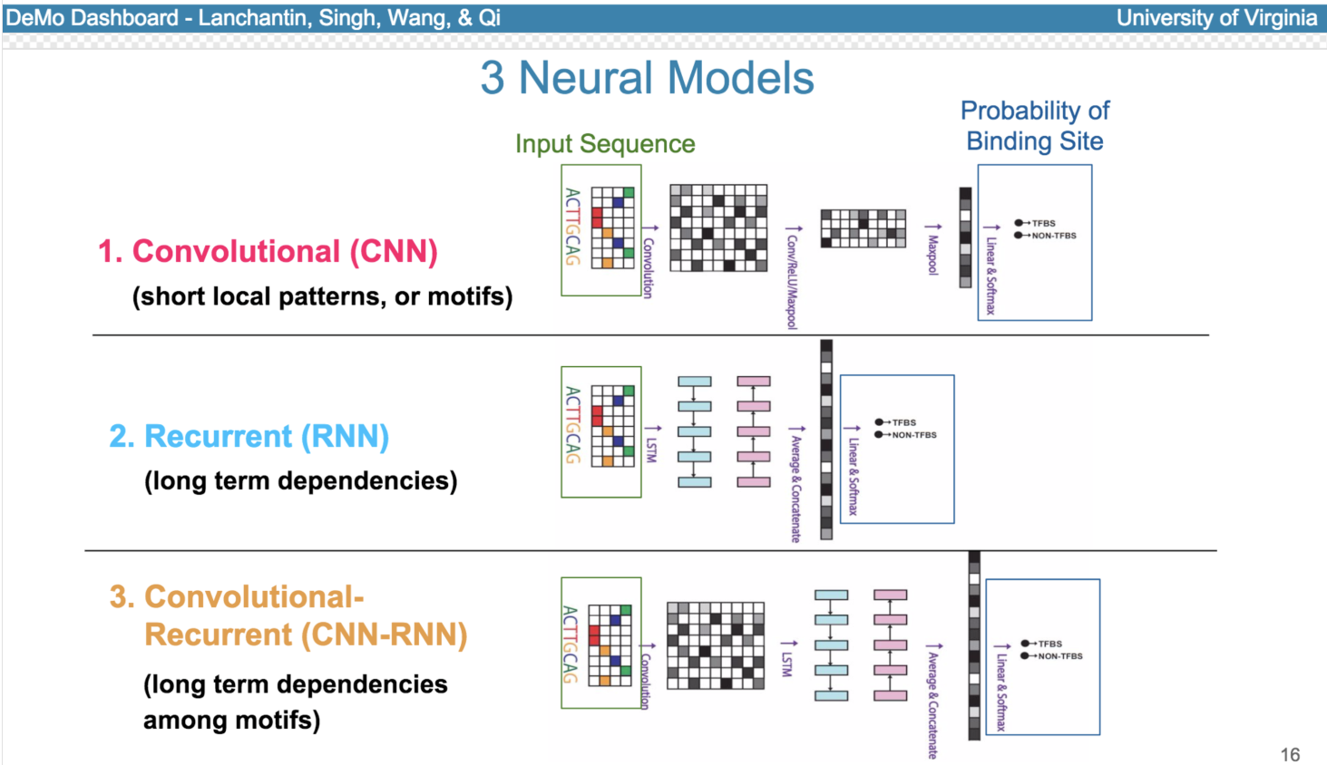

Slide 23
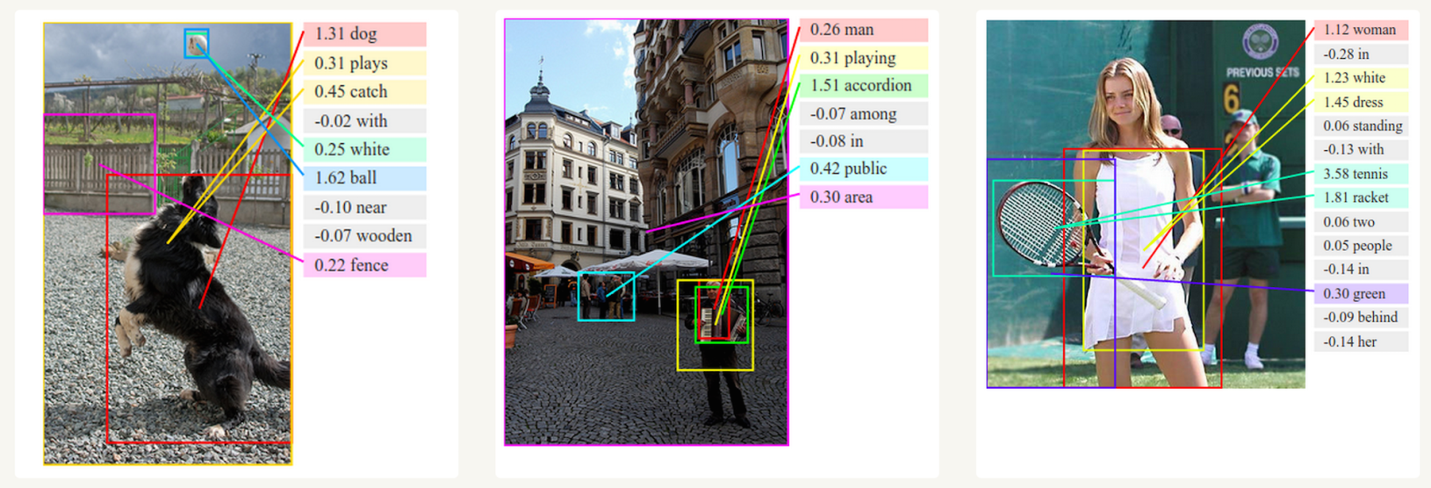

Slide 24
For example, in image recognition, they might learn to identify images that contain cats by analyzing example images that have been manually labeled as "cat" or "no cat" and using the results to identify cats in other images

Slide 25
An ANN is based on a collection of connected units or nodes called artificial neurons which loosely model the neurons in a biological brain

Slide 26
including
computer vision,
speech recognition,
machine translation,
social network filtering,
playing board and video games and medical diagnosis.

Slide 27
Hebb Learning
In the late 1940s, D.O. Hebb^{[4]} created a learning hypothesis based on the mechanism of neural plasticity that became known as Hebbian learning. Hebbian learning is unsupervised learning. This evolved into models for long term potentiation. Researchers started applying these ideas to computational models in 1948 with Turing's B-type machines.

Slide 28
Rosenblatt (1958) created the perceptron, an algorithm for pattern recognition
With mathematical notation,

Slide 29
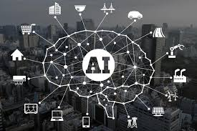
Artificial Intelligence

Slide 30
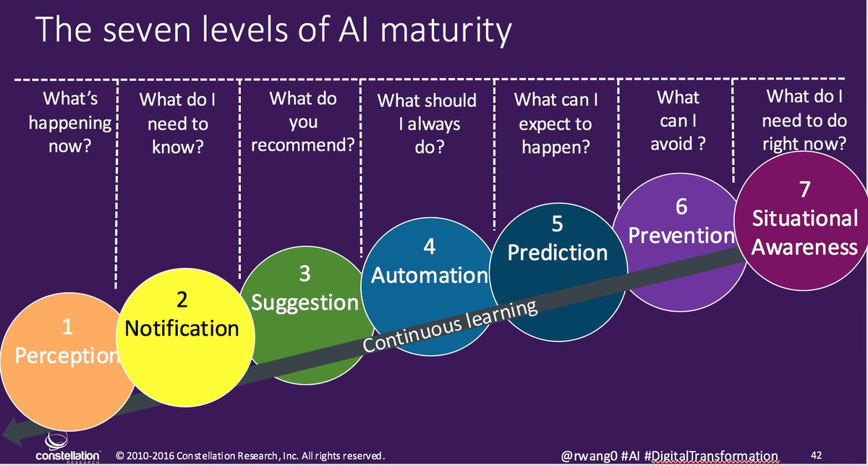

Slide 31
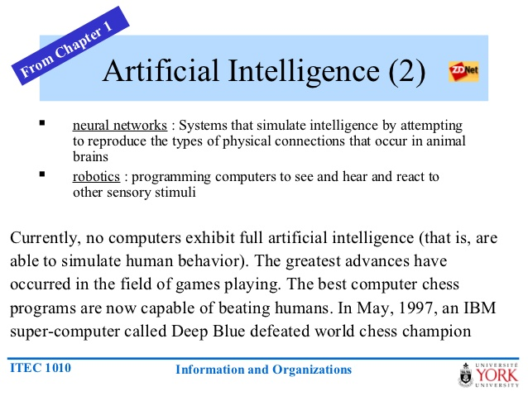

Slide 32
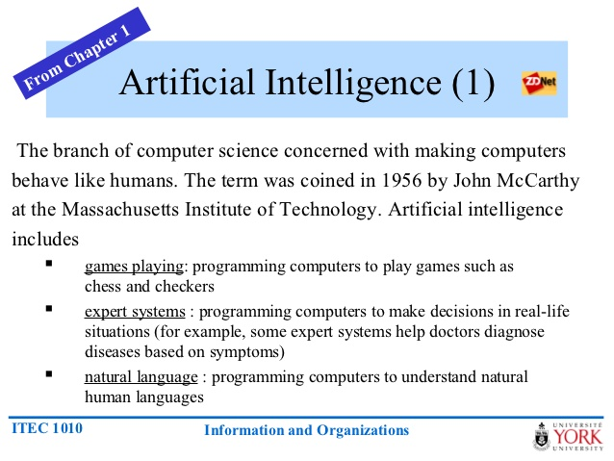

Slide 33
✓ Principal Component Analysis
✓ Time Series Analysis
✓ Unsupervised learning: Clustering
✓ Decision Trees
✓ K Nearest Neighbors (kNN)
Linear Regression,
Logical regression,
Market Basket Analysis,
Naïve Bayes,
✓ Random Forests
Natural Language processing - NLP
✓ Neural Networks ( Artificial Neural networks ) / Machine Learning / Deep Learning
Supervised and Unsupervised Learning

Slide 34
Neural network
Neural network is an information-processing machine and can be viewed as analogous to human nervous system
Just like human nervous system, which is made up of interconnected neurons, a neural network is made up of interconnected information processing units.

Slide 35
he information processing units do not work in a linear manner. In fact, neural network draws its strength from parallel processing of information, which allows it to deal with non-linearity.

Slide 36
Neural network is considered as one of the most useful technique in the world of data analytics. However, it is complex and is often regarded as a black box, i.e. users view the input and output of a neural network but remain clueless about the knowledge generating process

Slide 37
There are many learning rules that are used with neural network:
a) least mean square; b) gradient descent; c) newton’s rule; d) conjugate gradient etc.

Slide 38
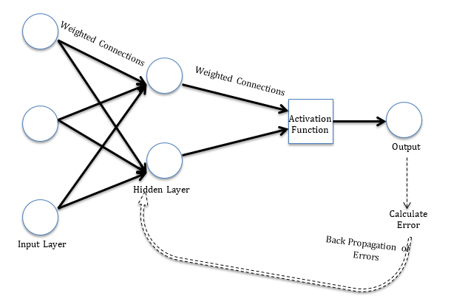

Slide 39
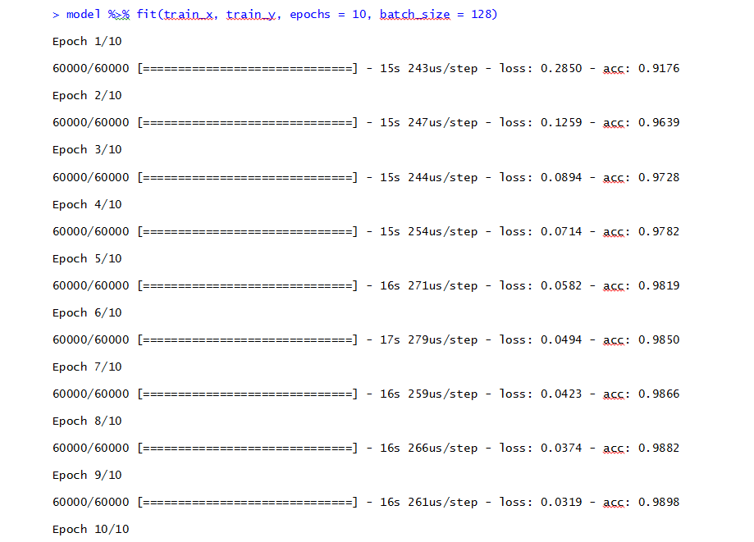

Slide 40
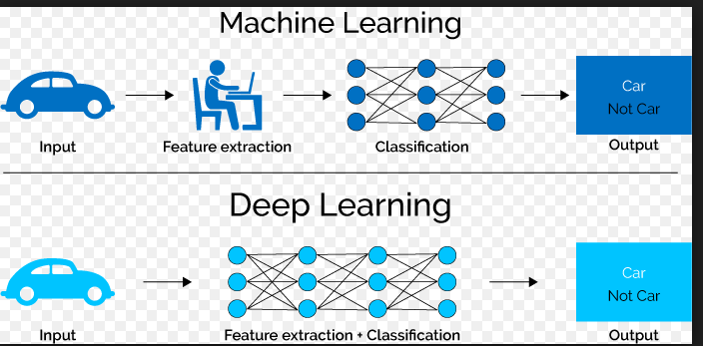

Slide 41
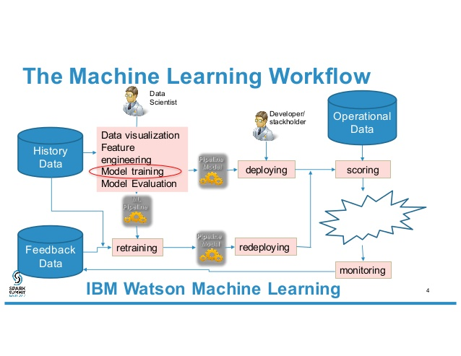

Slide 42
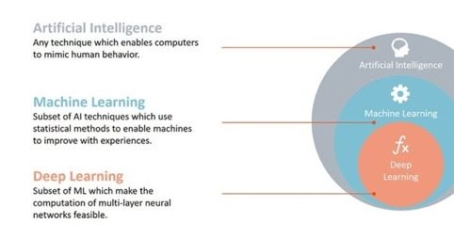

Slide 43
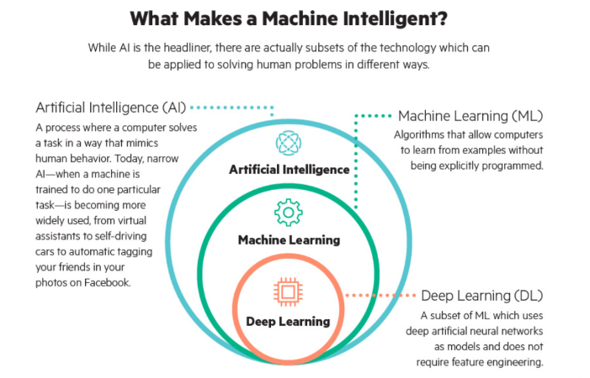

Slide 44
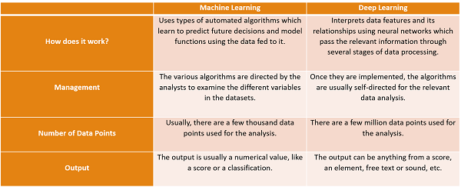

Slide 45
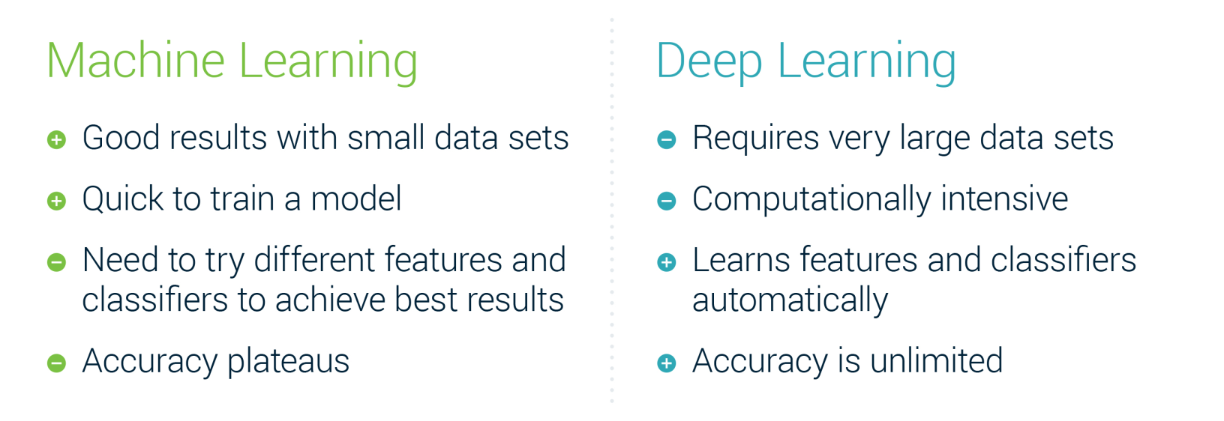

Slide 46
